Slide 1
miniDyno 2.0
Christoph Baumgartner
01/2023

Slide 2
The WHY?
Easy Load testing without complicated application specific testbenches
Algorithm testing
  Different load profiles for sensorless algorithms
AI/ML
  Capture data for model training
  Test different anomaly scenarios

Slide 3
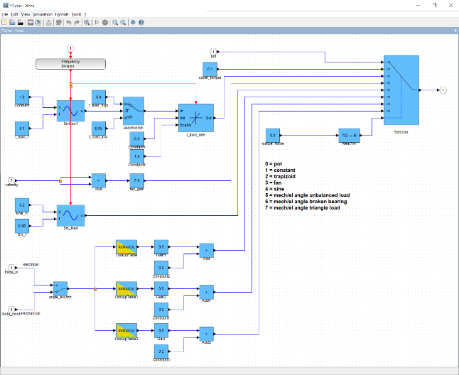
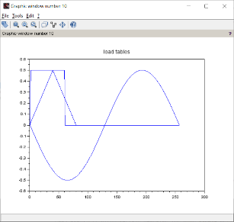
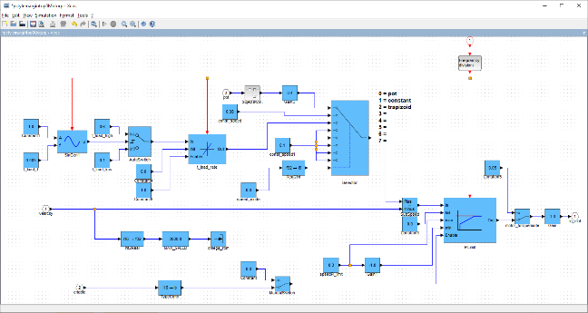
miniDyno 2.0 features
4Q operation (CW/CCW, motor/break)
  DYNO
    Constant load from potentiometer
    Constant load from variable
    Trapezoidal load (variables: frequency, raising/falling ramp, high/low value)
    Fan load (k*n²[rpm], variable:k
    Sine load ( variable: frequency, amplitude, offset)
    Angle dependent loads ( electrical/mechanical)
      3 different table dependent load profiles (variables: amplitude and offset)
        Unbalanced load (constant + sine)
        Broken bearing (constant + rectangle)
        Triangle ( constant + triangle)
      Various compressor load profiles possible
  MOTOR
    Constant torque
    Constant speed
      Potentiometer
      Variable
      Trapezoidal (variables: frequency, raising/falling ramp, high/low value)

Slide 4
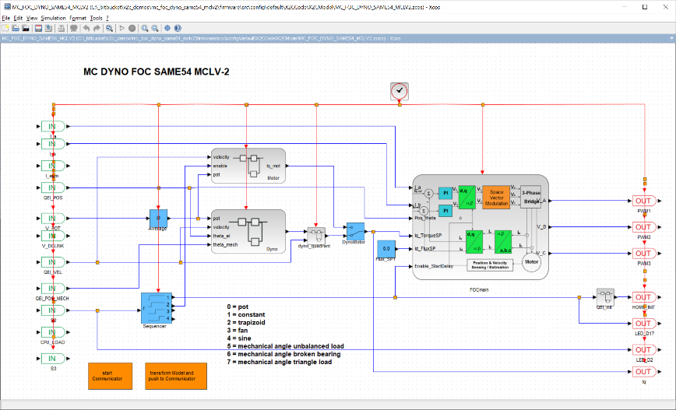
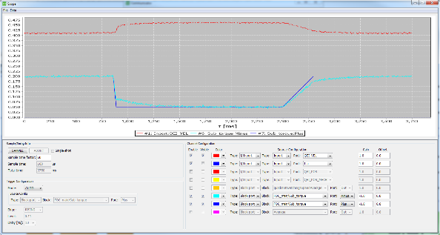
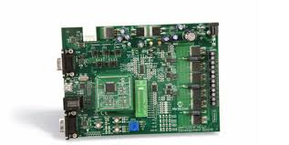
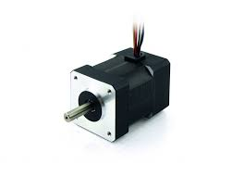
miniDyno 2.0
dyno / generator / break / motor
motor
Loadprofile
0 = pot
1 = constant
2 = trapizoid
3 = fan
4 = sine
5 = angle dependent
DUT
UART
connect the powersupply lines to make sure the energy created from the generator is used somewhere

Slide 5
Dual usage: SCILAB / X2C or Standalone
miniDyno 2.0 usage
  Standalone
    Microchip programmer (ICD4, PICKit4, SNAP)
    Software to program a hex file (MPLAB X or IPE)
    No SCILAB, X2C and XC32 compiler required
  SCILAB/X2C environment requirements
    Scilab 6.1.1 + X2C 6.4
    MPLAB X development environment (MPLAB X 6, Harmony3, XC32 free)
    Microchip programmer (ICD4, PICKit4, SNAP)

Slide 6
How to use the X2C based DYNO standalone
Harware setup:
  MCLV-2
  ATSAME54
  Hurst300 motor with encoder
  RS232 cable
Software setup
  Microchip programmer (SW and HW)
Settings
  JP1,2,3 -> Curr
  JP4,5 -> UART
  M1 – red
  M2 – white
  M3 – black
  HA – QEI white
  HB – QEI blue
ATTENTION:
Make sure the DYNO board power is connected to the motor board!

Slide 7
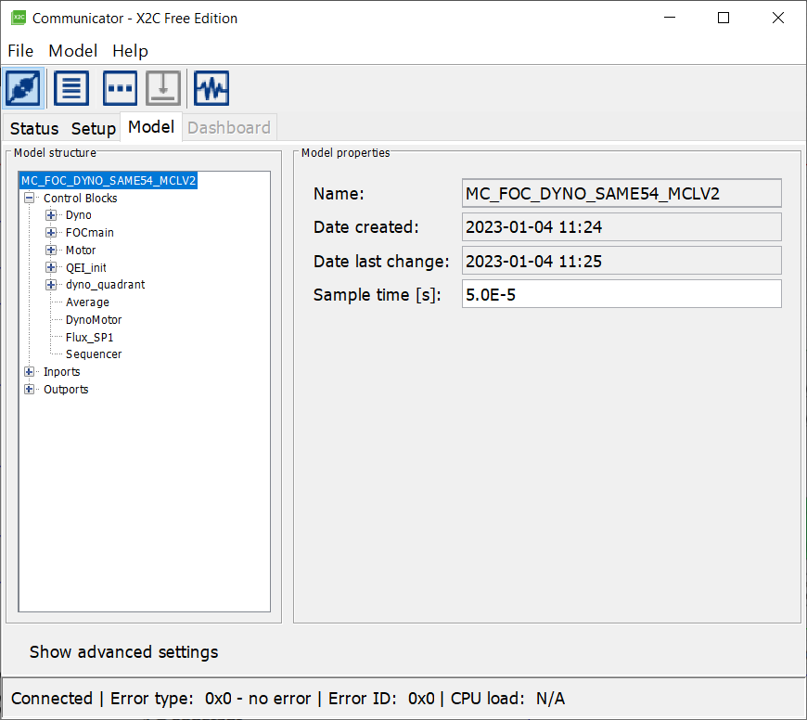
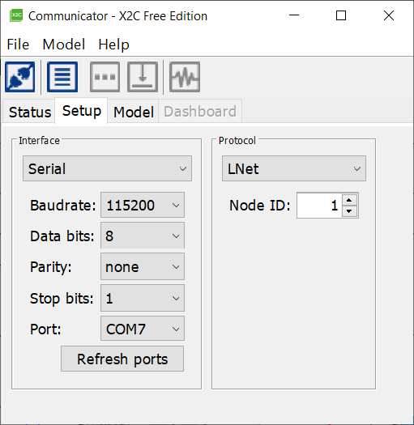
Firmware:
Bitbucket
  https://bitbucket.microchip.com/projects/X2C/repos/mc_foc_dyno_same54_mclv2/
Move to [..\mc_foc_dyno_same54_mclv2\doc\standalone]
Program [MC_FOC_DYNO_SAME54_MCLV2.X.production.hex] onto your SAME54 PIM
Disconnect the programmer and reset the MCLV-2 board
Execute [start.bat]
3: change to [Model] tab
2: press the connect icon
1: select your COM port

Slide 8
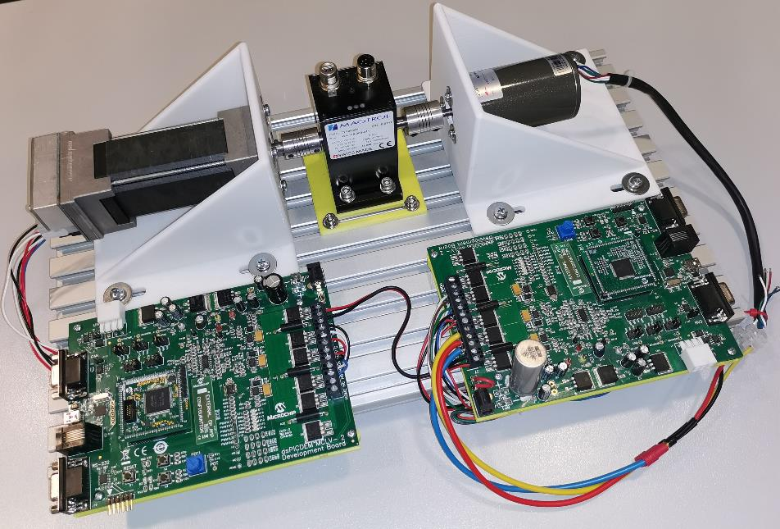

miniDyno 2.0 setup
Magtrol TS105/011
torque sensor (optional)
miniDyno
motor

Slide 9
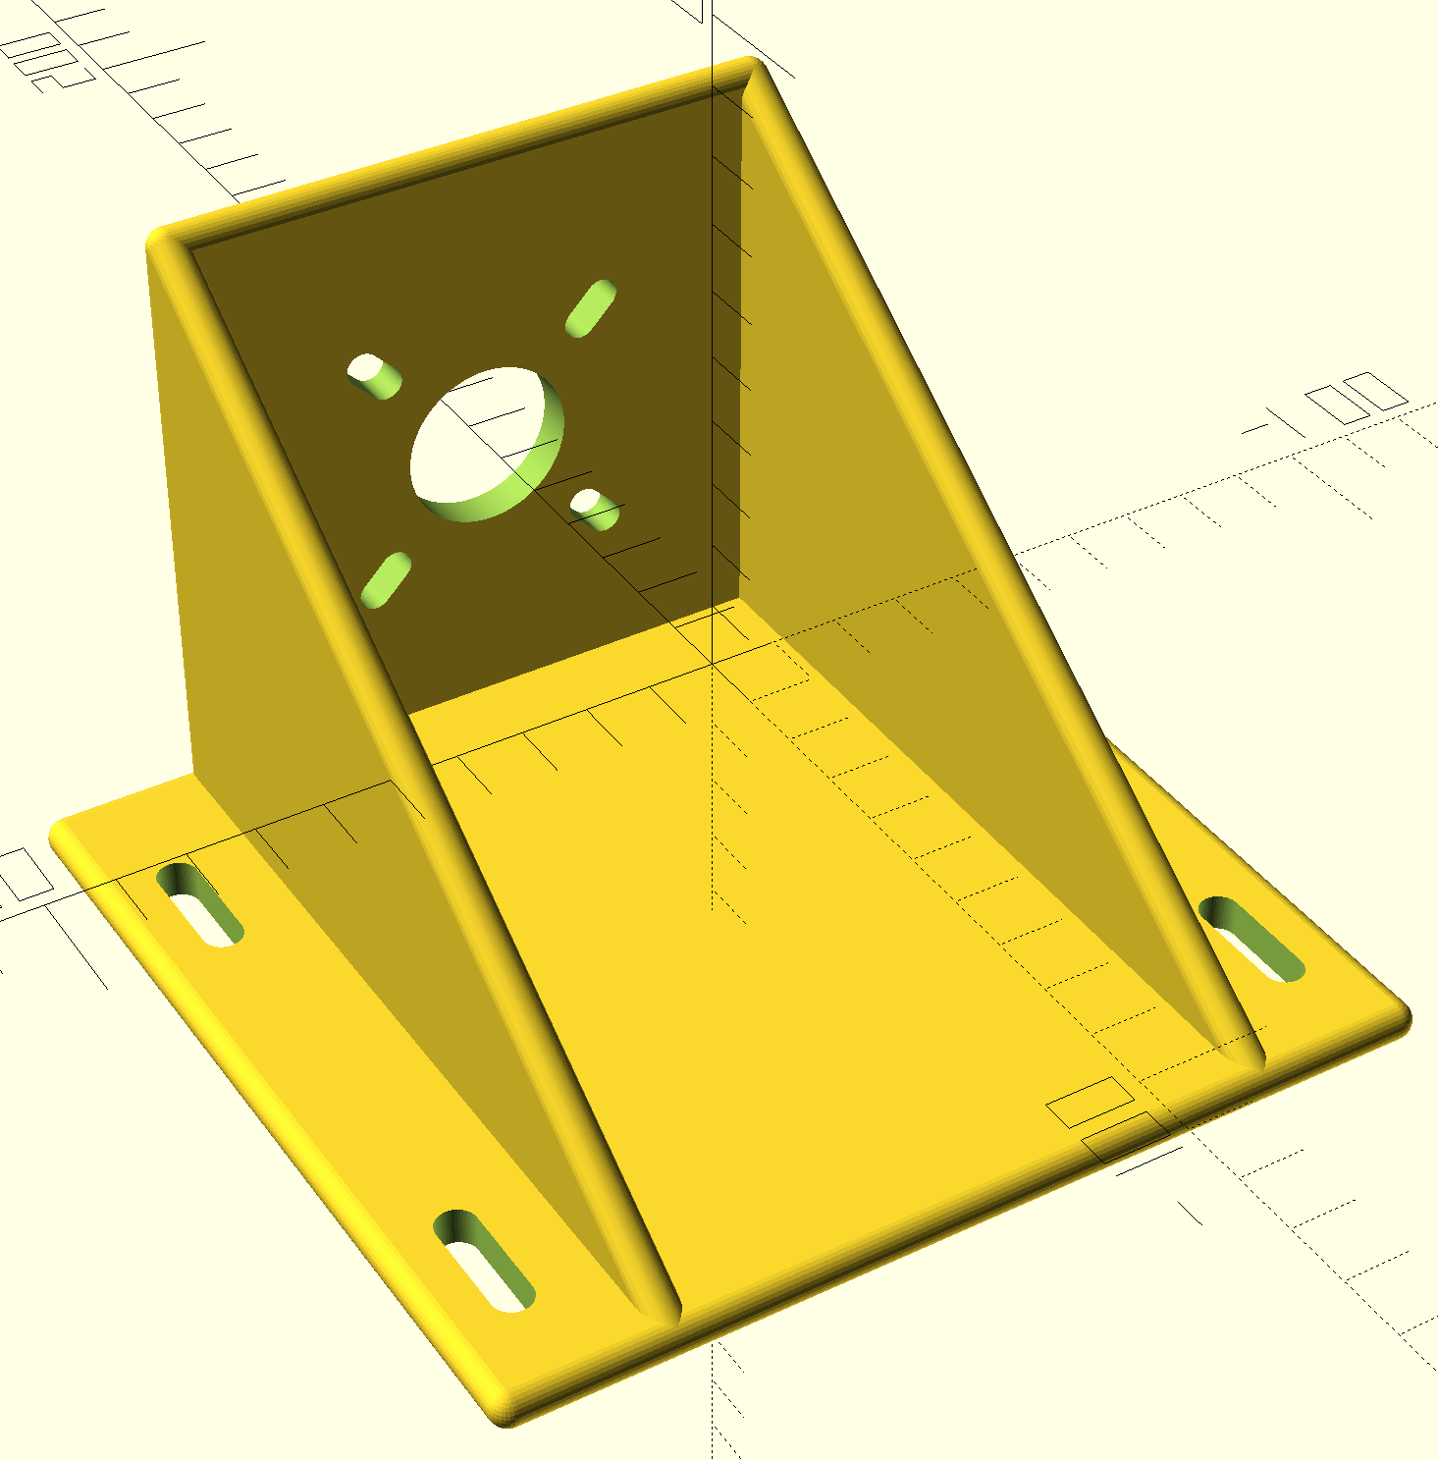
Unified motor bracket:
OpenSCAD design
Same basic dimensions
Motor mounting can be adjusted
3D printable
  PLA
  Layer 0.2mm
  Infill 60%
..\mc_foc_dyno_same54_mclv2\doc\3Dparts

Slide 10
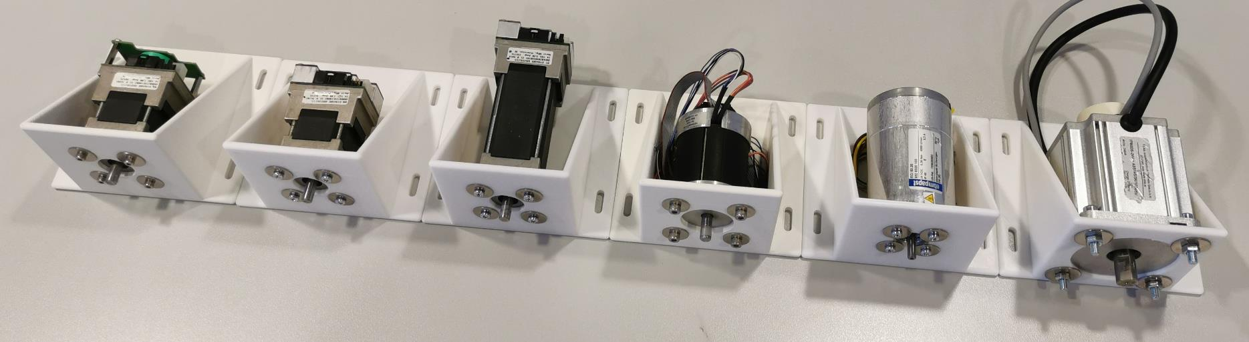
Unified motor bracket:

Slide 11
Future enhancements:
Motor position control (for ZSMT tuning)
Standalone GUI
Using torquesensor for calibration
  Real torquecontrol
Add input/output power measurement
MCHV-2/3 version in preparation
Porting to MCLV-48V-300W

Slide 12
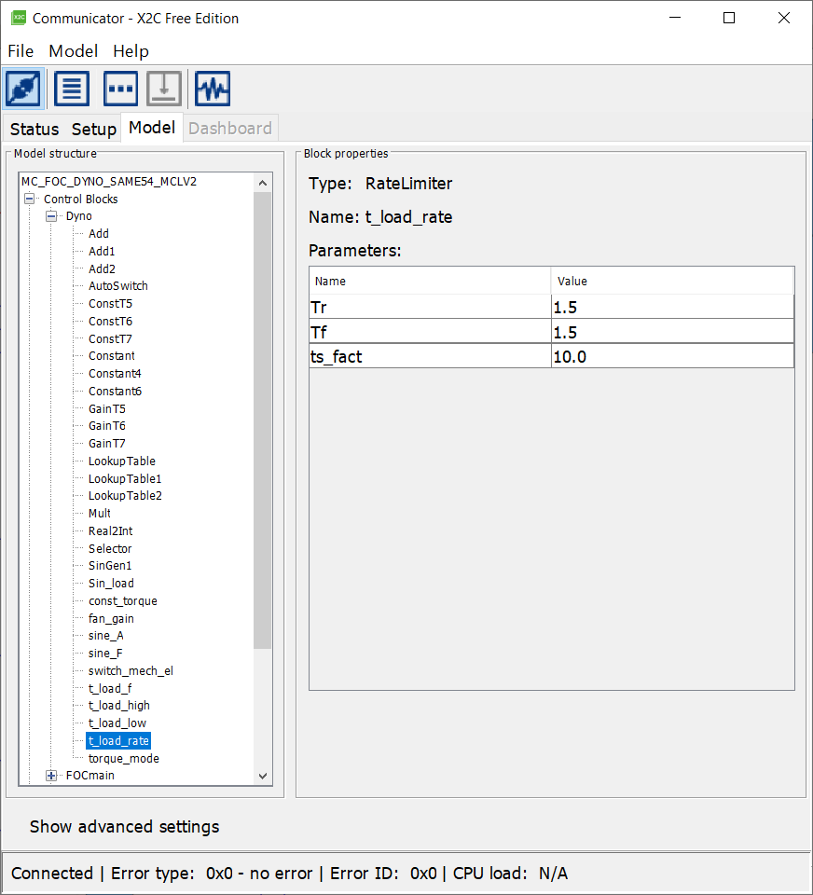
Modify [Dyno] paramters – torque_profile
torque_mode
0: Constant load: potentiometer
1: Constand load:
[const_torque:Value]
2: Trapizoid load:
  [t_load_f:Value]
  [t_load_high:Value]
  [t_load_low:Value]
  [t_load_rate:Tr]
  [t_load_rate:Tf]
3: Fan load:
  [fan_gain:Gain]
4: Sine load:
  [sine_A:Value]
  [Sin_f:Value]
  [Sin_load:fmax]
  [Sin_load:Offset]
5: unbalanced load:
  [GainT5:Value]
  [ConstT5:Value]
6: broken bearing:
  [GainT6:Value]
  [ConstT6:Value]
7: triangle:
  [GainT7:Value]
  [ConstT7:Value]

Slide 13
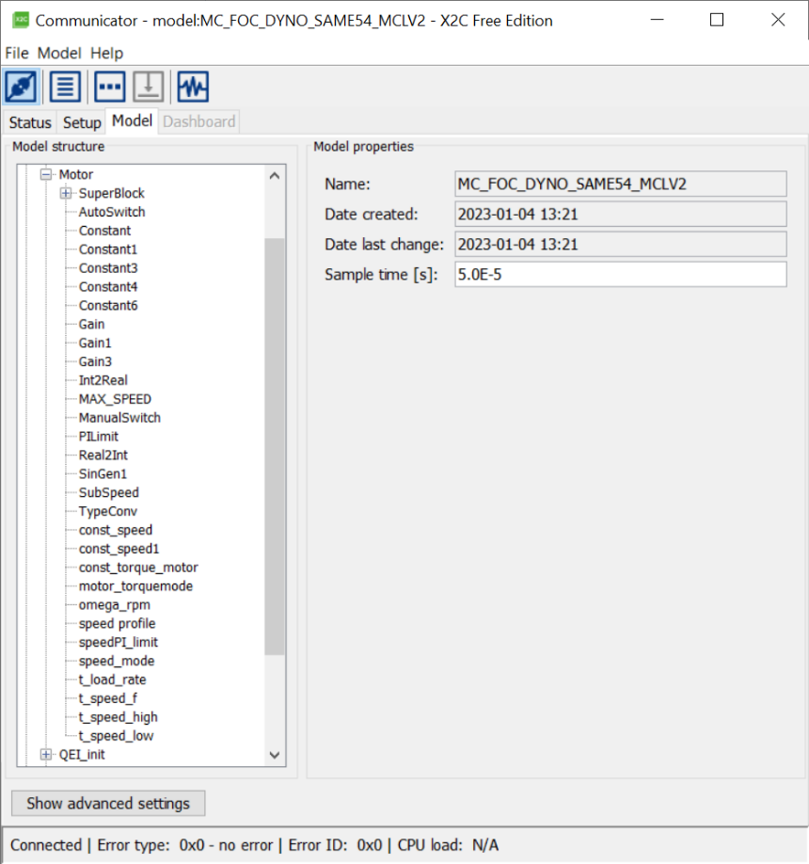
Modify [Motor] paramters – torque_profile
speed_mode
0: Constant speed: potentiometer
1: Constand speed:
[const_speed:Value]
2: Trapizoid load:
  [t_speed_f:Value]
  [t_ speed _high:Value]
  [t_ speed _low:Value]
  [t_ speed _rate:Tr]
  [t_speed_rate:Tf]
[motor_torquemode]
1=speed control
0=torque control
Torquevalue
[const_torque_mode:Value]
Switch between Dyno/Motor
[DynoMotor]
1=Dyno
0=Motor

Slide 14
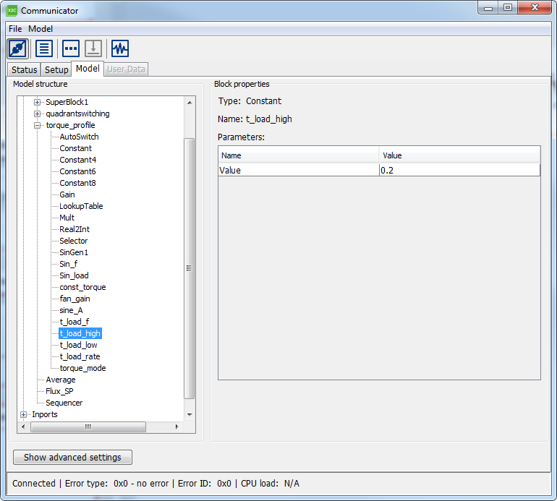
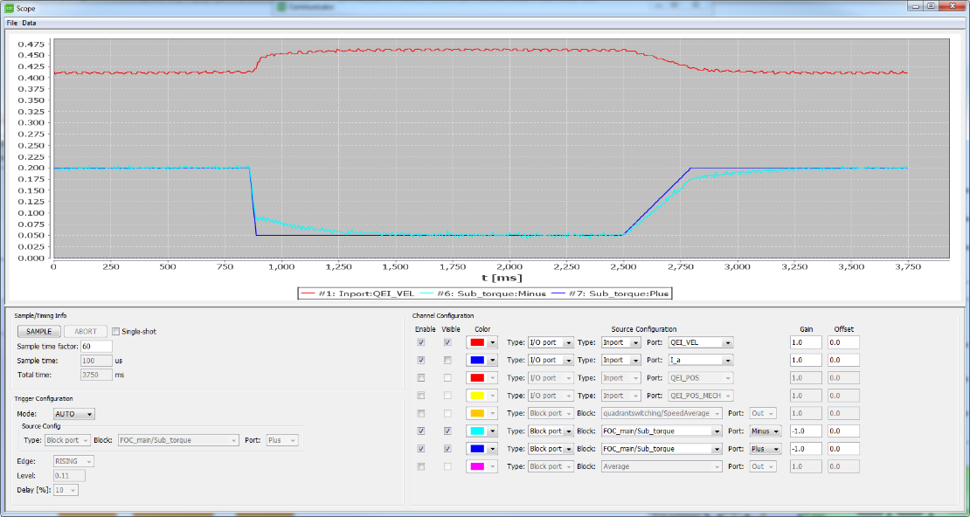
Scope
Start Scope
Set „Sample Time Factor“
Press the „Sample“ Button to monitor signals.

